Slide 1
CS 5402 Introduction to Data Mining
Discretization
v.1
Perry B. Koob, koobp@mst.edu

Slide 2
What we are going to learn.
Discretization
Binning
Entropy-based Discretization
Error-based Discretization
Reversing Discretization

Slide 3
Discretization
Discretization is taking interval and ratio data and making it nominal.
Global Discretization
Discretization happens before learning
Local Discretization
Discretization happens at the point of the splitting decision

Slide 4
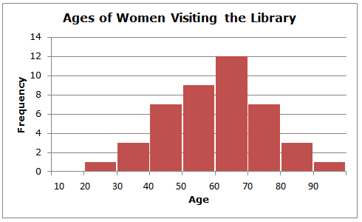
Discretization
Unsupervised Discretization is discretization that happens independent of classes.
Equal-interval Binning
https://www.softschools.com/math/probability_and_statistics/histogram/

Slide 5
Discretization
Equal-frequency Binning or histogram equalization

Slide 6
Discretization
Entropy Based
Sort instances by attribute value and then split them based on information gain. info[x,y] = - p(x) * log2(p(x)) + - p(y) * log2(p(y)) bits info([a₁,b₁],[a₂,b₂])

Slide 7
Information Calculation
Information calculations are based on the Shannon Entropy from Claude Shannon’s 1948 paper "A Mathematical Theory of Communication".
Info[x₁,x₂,...,x_{n}] = -Σp(x_{i})log₂(p(x_{i})) where i = 1,...,n
Info[x,y] = - p(x) * log₂(p(x)) + - p(y) * log₂(p(y)) bits
These Information calculations may be used in Feature Reduction.

Slide 8
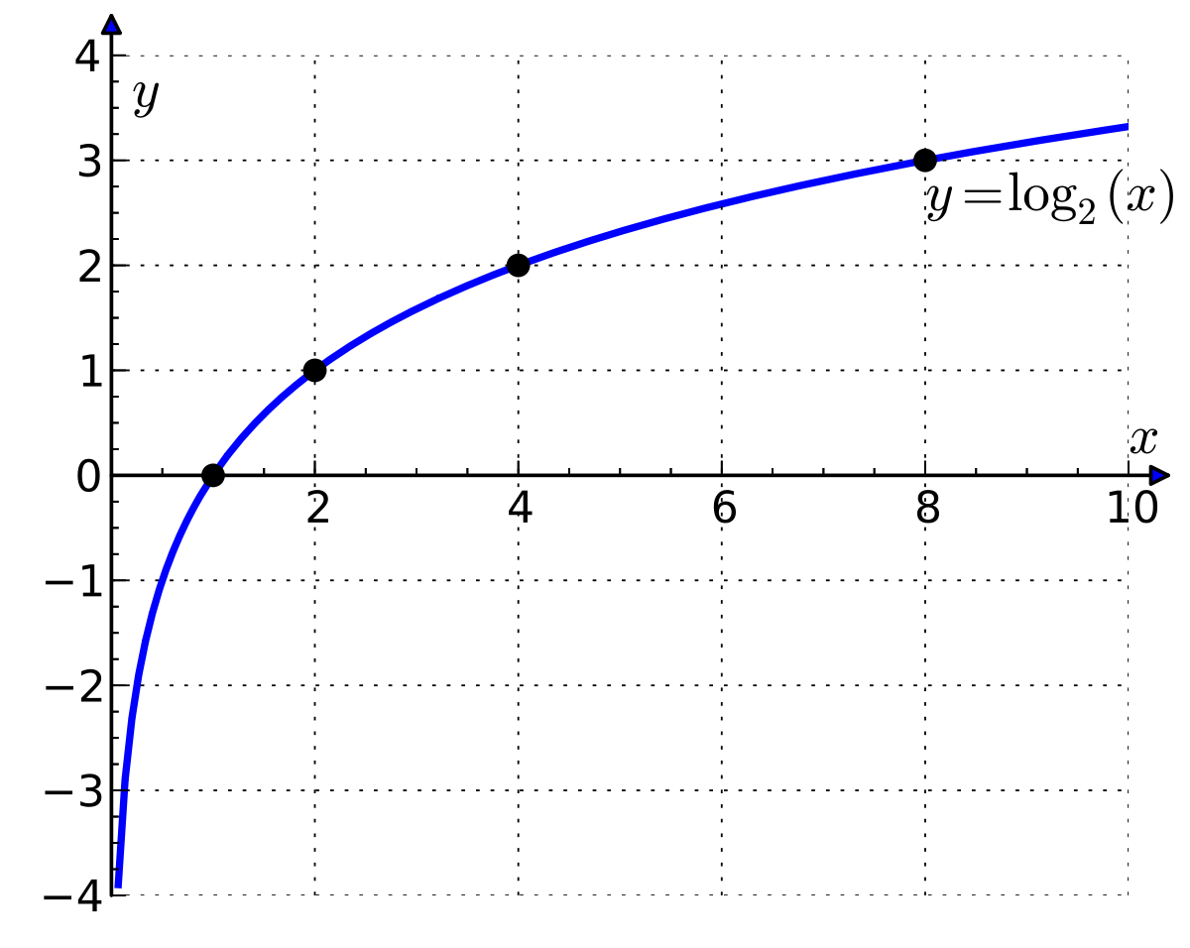
Information Calculation
Information calculations are based on the Shannon Entropy from Claude Shannon’s 1948 paper "A Mathematical Theory of Communication".
Info[x₁,x₂,...,x_{n}] = -Σp(x_{i})log₂(p(x_{i})) where i = 1,...,n
Info[x,y] = - p(x) * log₂(p(x)) + - p(y) * log₂(p(y)) bits
Notice the log base 2.
This means when p(x_{i}) = 1 , then log2(1) = 0,
and when p(x_{i}) = 0 , then log2(0) = undefined.

Slide 9
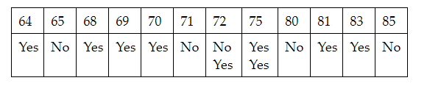
Discretization
Entropy Based
Sort instances by attribute value and then split them based on information gain.
Example: Say we want to consider a split at 71.5

Slide 10
Discretization
Entropy Based
Sort instances by attribute value and then split them based on information gain.
Example: Say we want to consider a split at 71.5
values below 71.5 classify as 4 Yes and 2 No values above 71.5 classify as 5 Yes and 3 No

Slide 11
Discretization
Entropy Based
Sort instances by attribute value and then split them based on information gain.
Example: Say we want to consider a split at 71.5
values below 71.5 classify as 4 Yes and 2 No values above 71.5 classify as 5 Yes and 3 No
info([4,2],[5,3]) = p([4,2]) x info([4,2]) + p([5,3]) x info(5,3)

Slide 12
Discretization
Entropy Based
Sort instances by attribute value and then split them based on information gain.
Example: Say we want to consider a split at 7.5
values below 71.5 classify as 4 Yes and 2 No values above 71.5 classify as 5 Yes and 3 No
We split where the information value is the smallest, meaning the gain is the greatest.

Slide 13
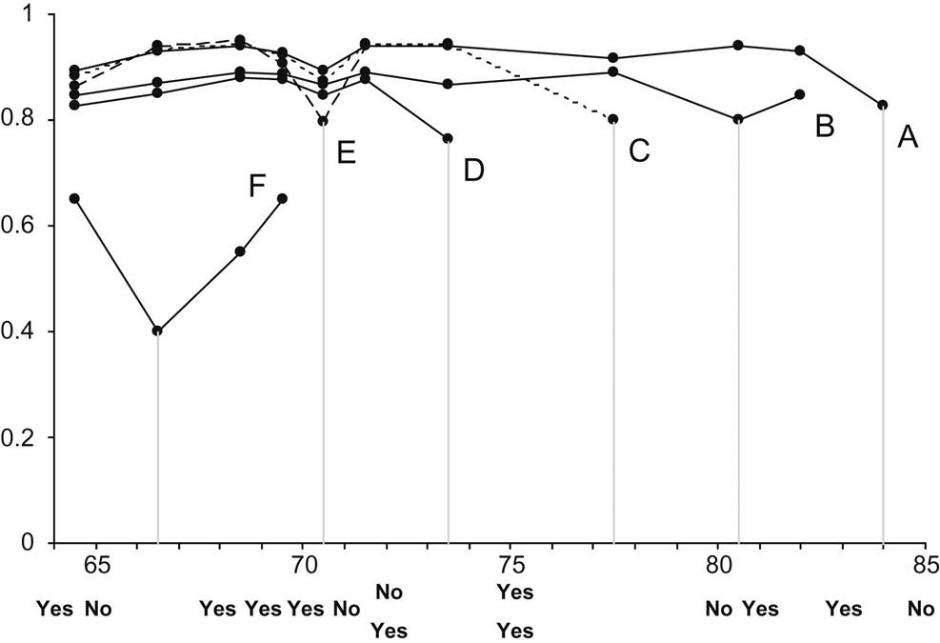
Discretization

Slide 14
Discretization
Top-Down
Start with all intervals in one and then split it into smaller intervals until stopping criteria is met.
Bottom-Up
Place each value into its own interval and then merge the values.

Slide 15
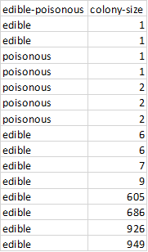
From (Manning, Holmes, & Witten 1995).
Sort the tuples by attribute value.
Form intervals by placing a split point between every pair of different values.
Repeat until there are no more split points.
remove split points between intervals that predict the same class,
examine the decrease in accuracy which would result from removing each split point,
remove the least costly split point (in the event of a tie, choose one at random);
Choose the best split point on the accuracy vs number of splits curve.
Discretization

Slide 16
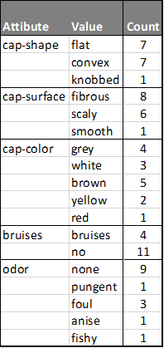
Reversing the Discretization process
What is wrong with this?
 | cap-shape
fibrous | 1
scaly | 2
smooth | 3

Slide 17
Reversing the Discretization process
What is wrong with this?
Implied order and fixed scale between attribute values.
 | cap-shape
fibrous | 1
scaly | 2
smooth | 3

Slide 18
Reversing the Discretization process
Use something like this. A panel of binary variables.
 | fibrous | scaly | smooth
True | 1 | 1 | 1
False | 0 | 0 | 0

Slide 19
Reversing the Discretization process
If you are using regression with a β₀ use something like this. A panel of binary variables with an implied default value.
 | scaly | smooth
True | 1 | 1
False | 0 | 0

Slide 20
What we covered.
Discretization
Binning
Entropy-based Discretization
Error-based Discretization
Reversing Discretization

Slide 21
References
Shmueli, G., Bruce, P. C., Yahav, I., Patel, N. R., & Lichtendahl Jr, K. C. (2017). Data mining for business analytics: concepts, techniques, and applications in R. John Wiley & Sons.
Witten, I. H., Frank, E., Hall, M. A., & Pal, C. J. (2016). Data Mining: Practical Machine Learning Tools and Techniques.

